Slide 1


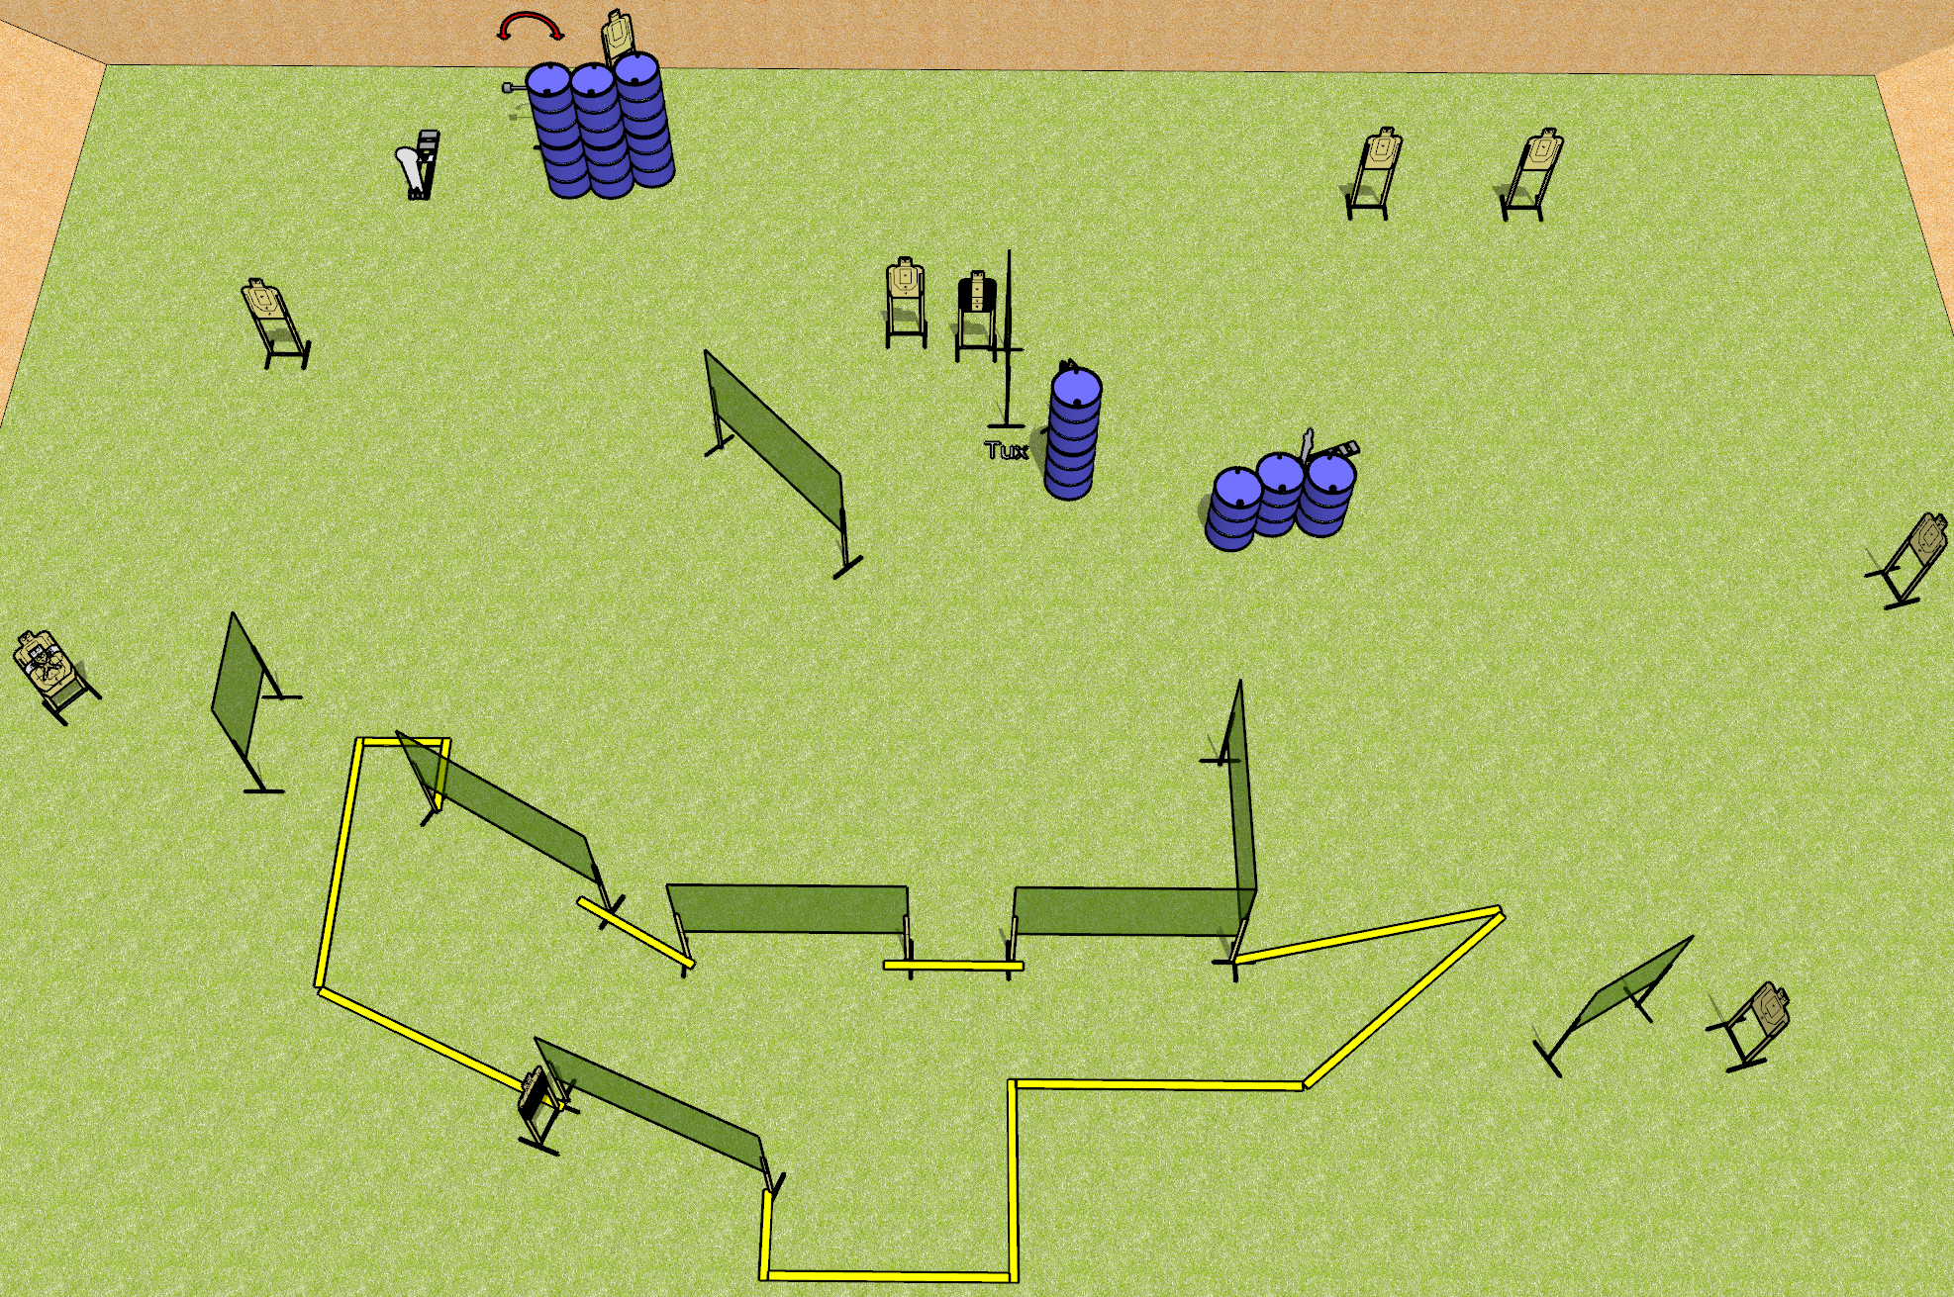
 | Dothan Gun Club – USPSA Match Bogged Down Course Designer : Drew Coleman Bay: 2
Round Count 28 rounds 13 USPSA 1 colt, 1 mini
Equipment List 15 wall feet 1 50%, 2 tux 1 NS 11 targets (10 + 1NS)

Slide 2
Bogged Down
Written Stage Briefing
Scoring: Comstock Rounds: 28
Targets: 13 USPSA, 2 steel
Handgun start position: anywhere inside the shooting area, wrists below belt. Handgun is loaded and holstered.
PCC start position: anywhere inside the shooting area, stock on belt. Loaded carbine is held with both hands.
Stage Procedure: on the audible start signal, engage targets as they become available from within the shooting area.
The swinger is activated by P1 and remains visible at rest.

